Slide 1
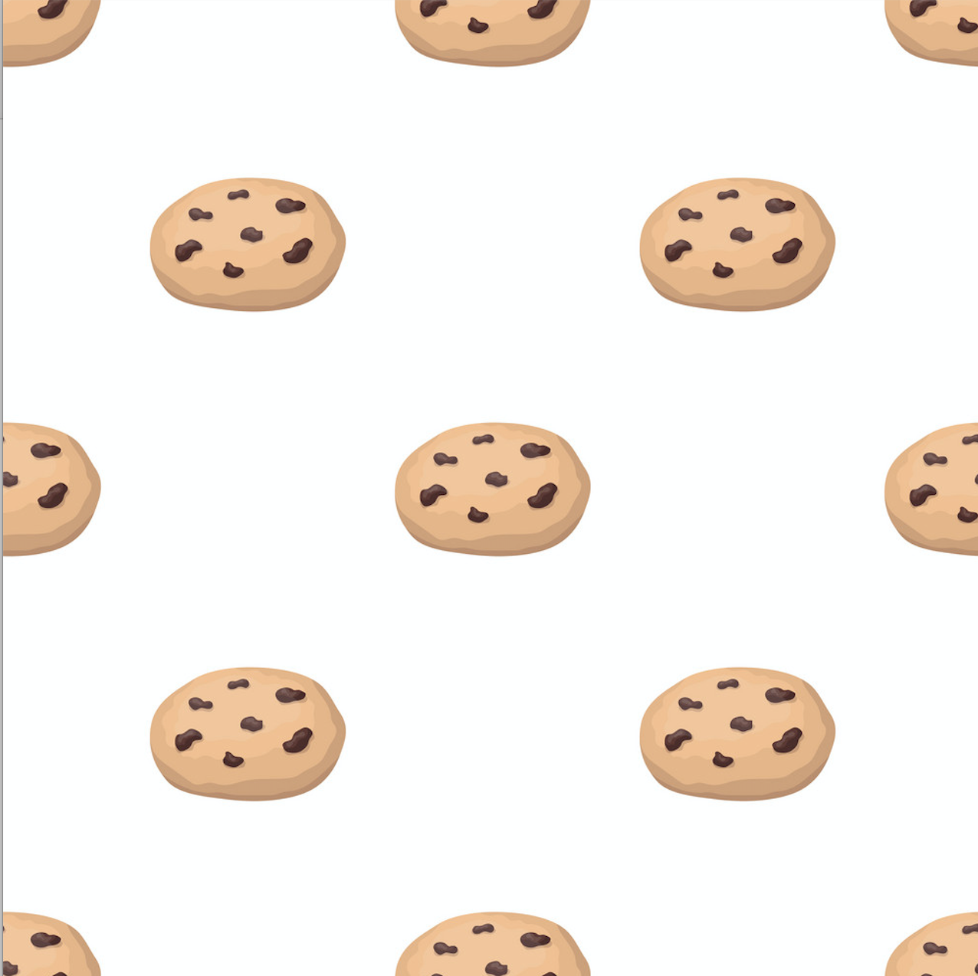

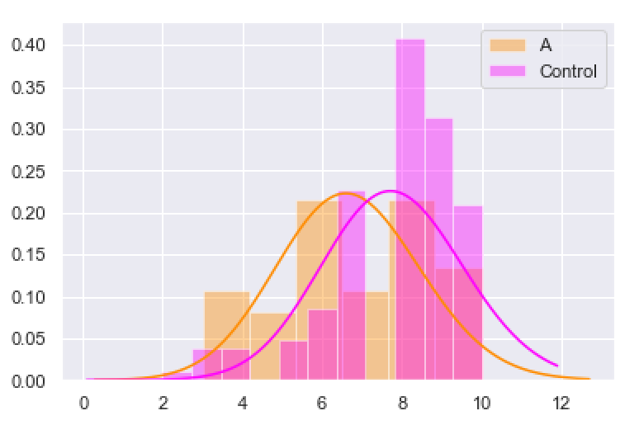
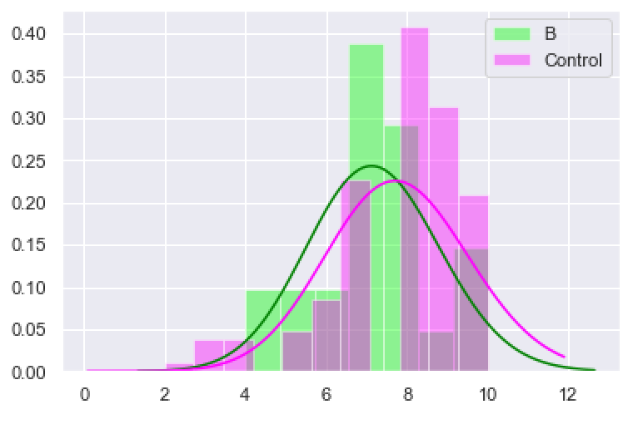
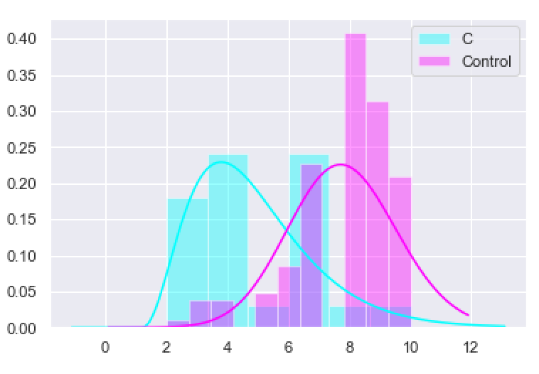
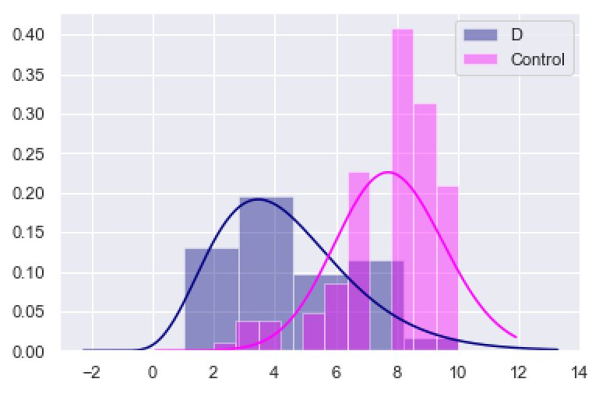
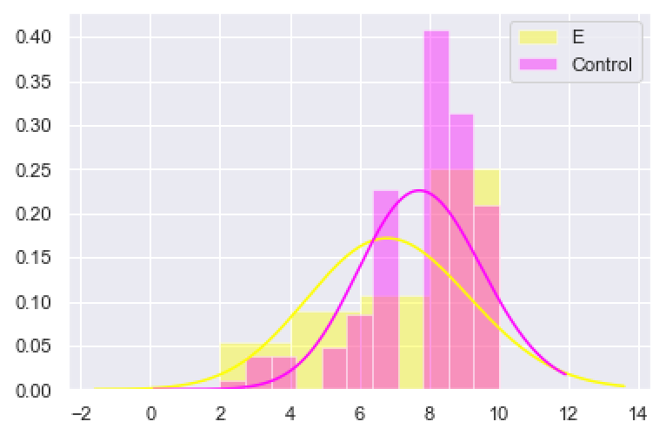
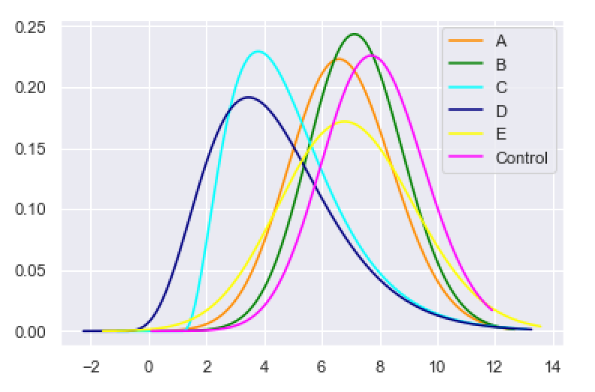
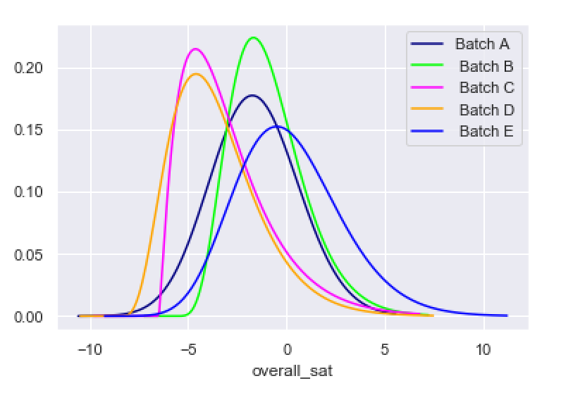
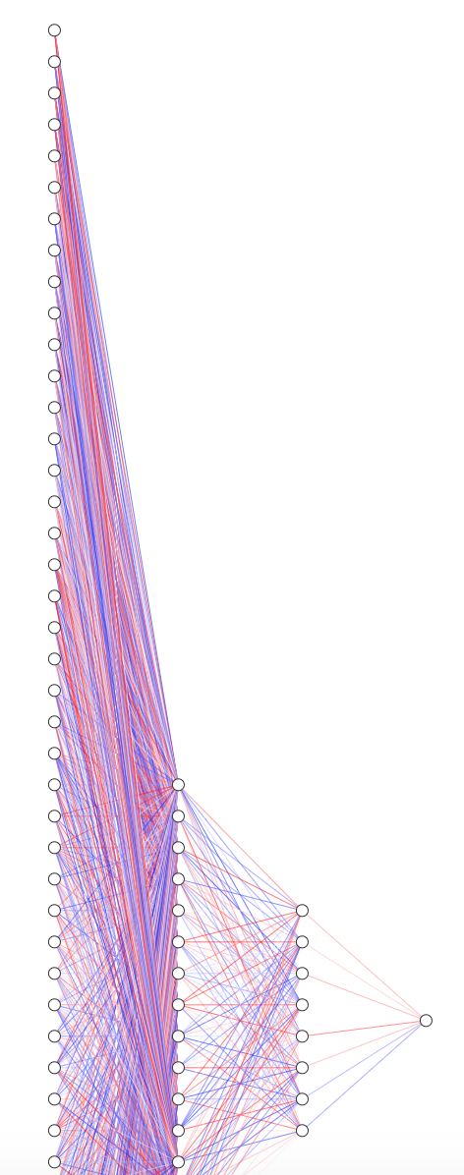


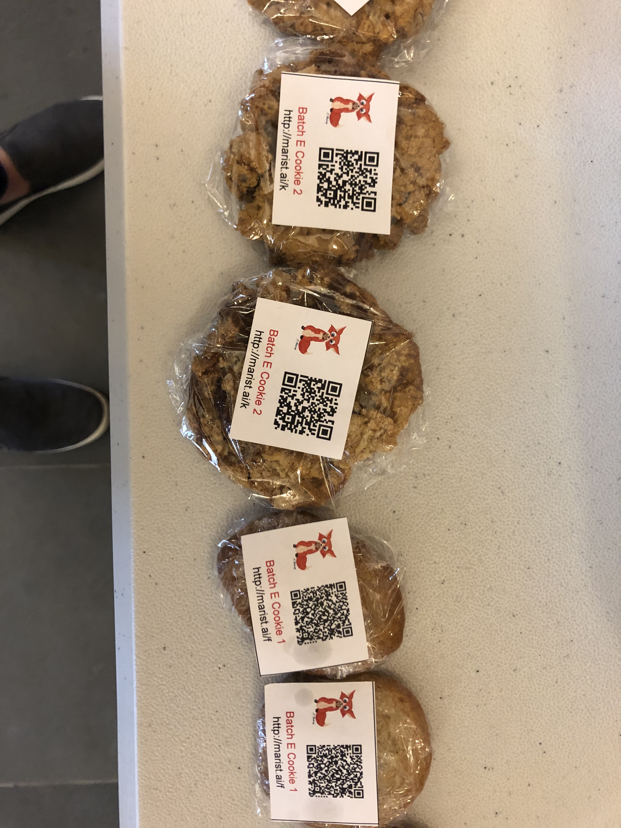
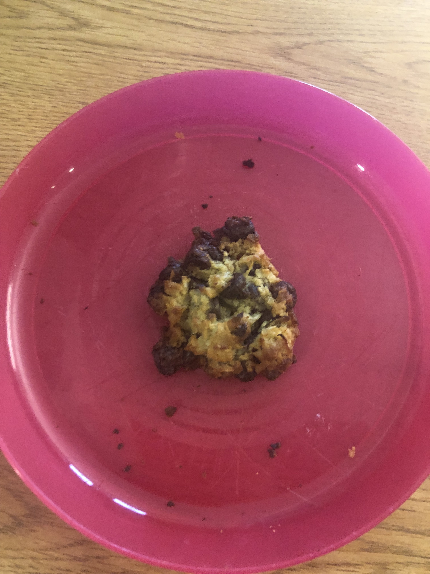
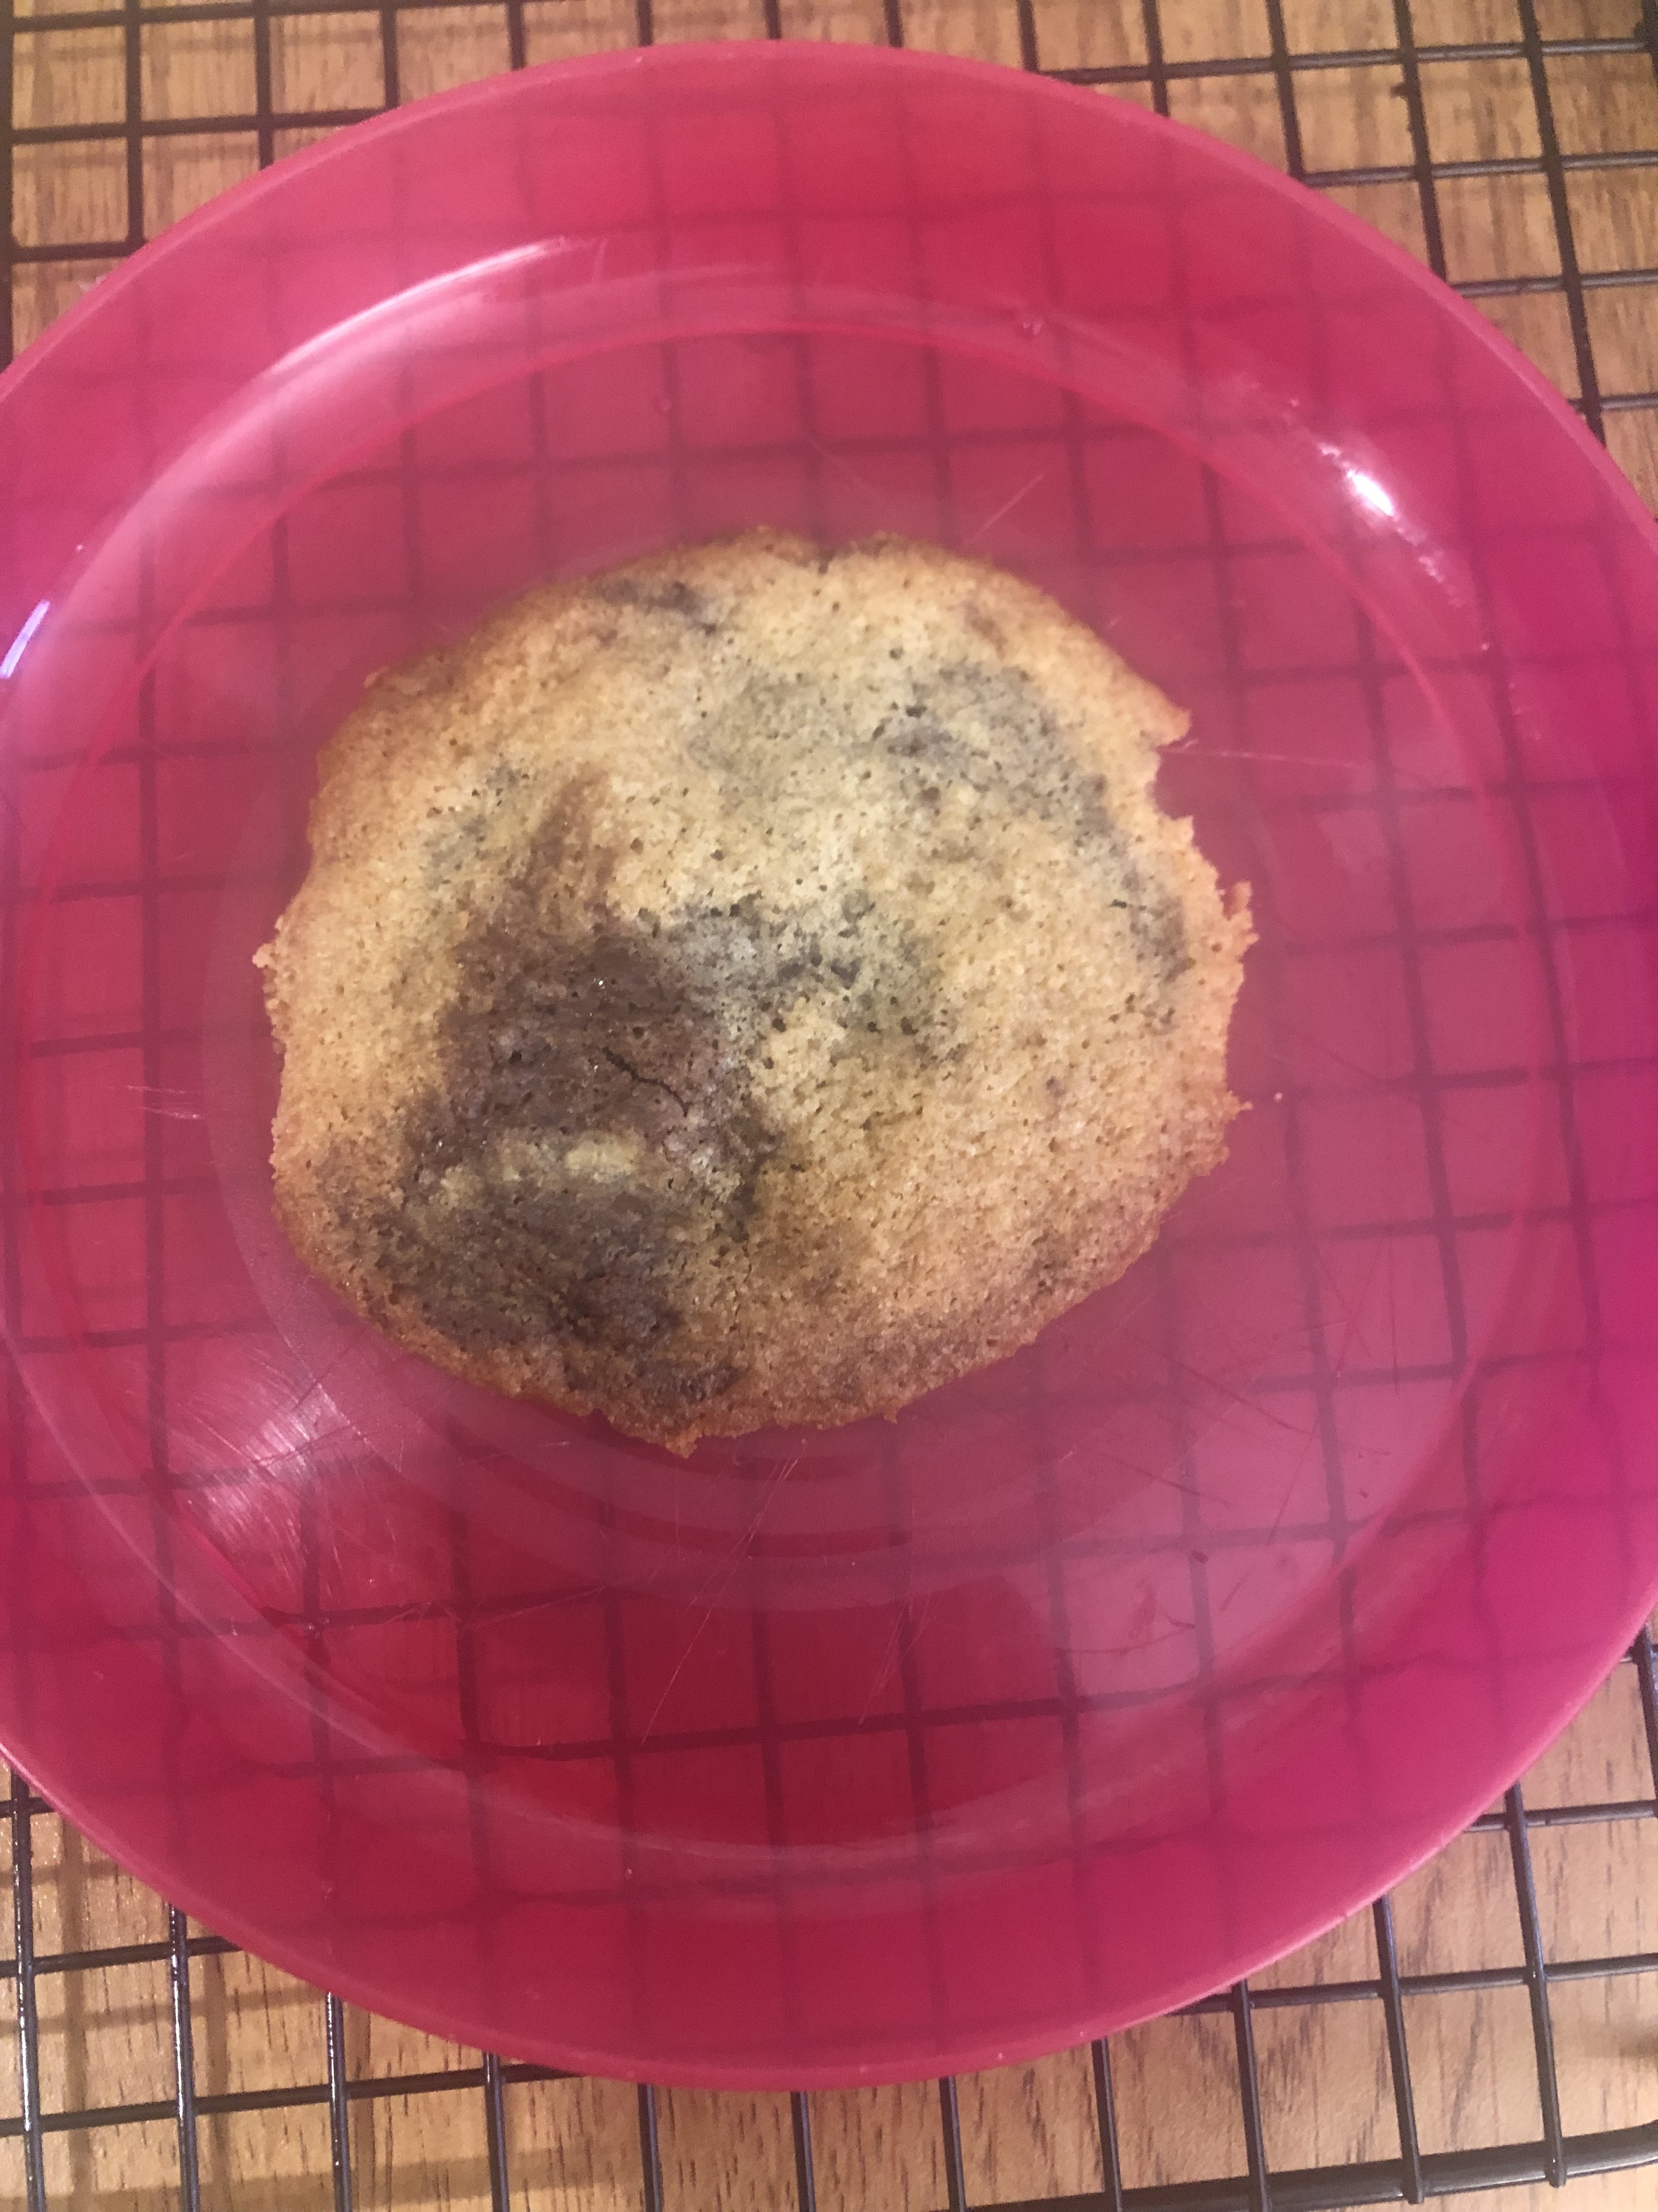
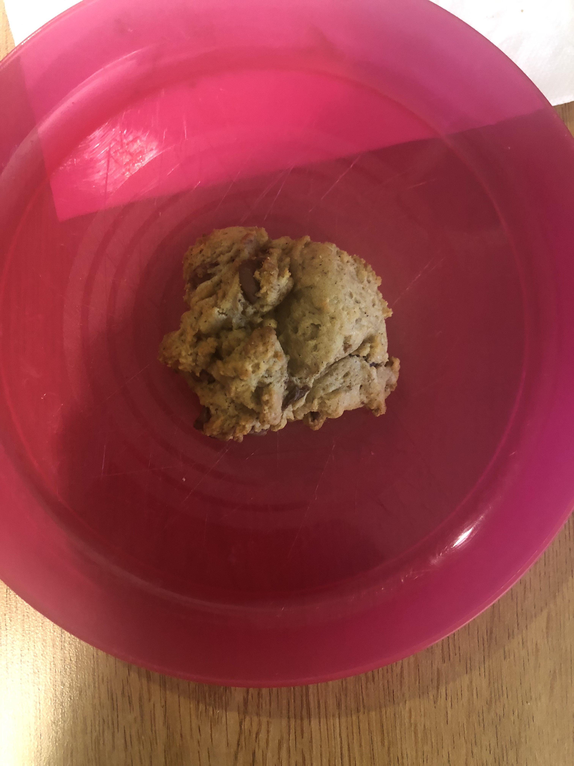
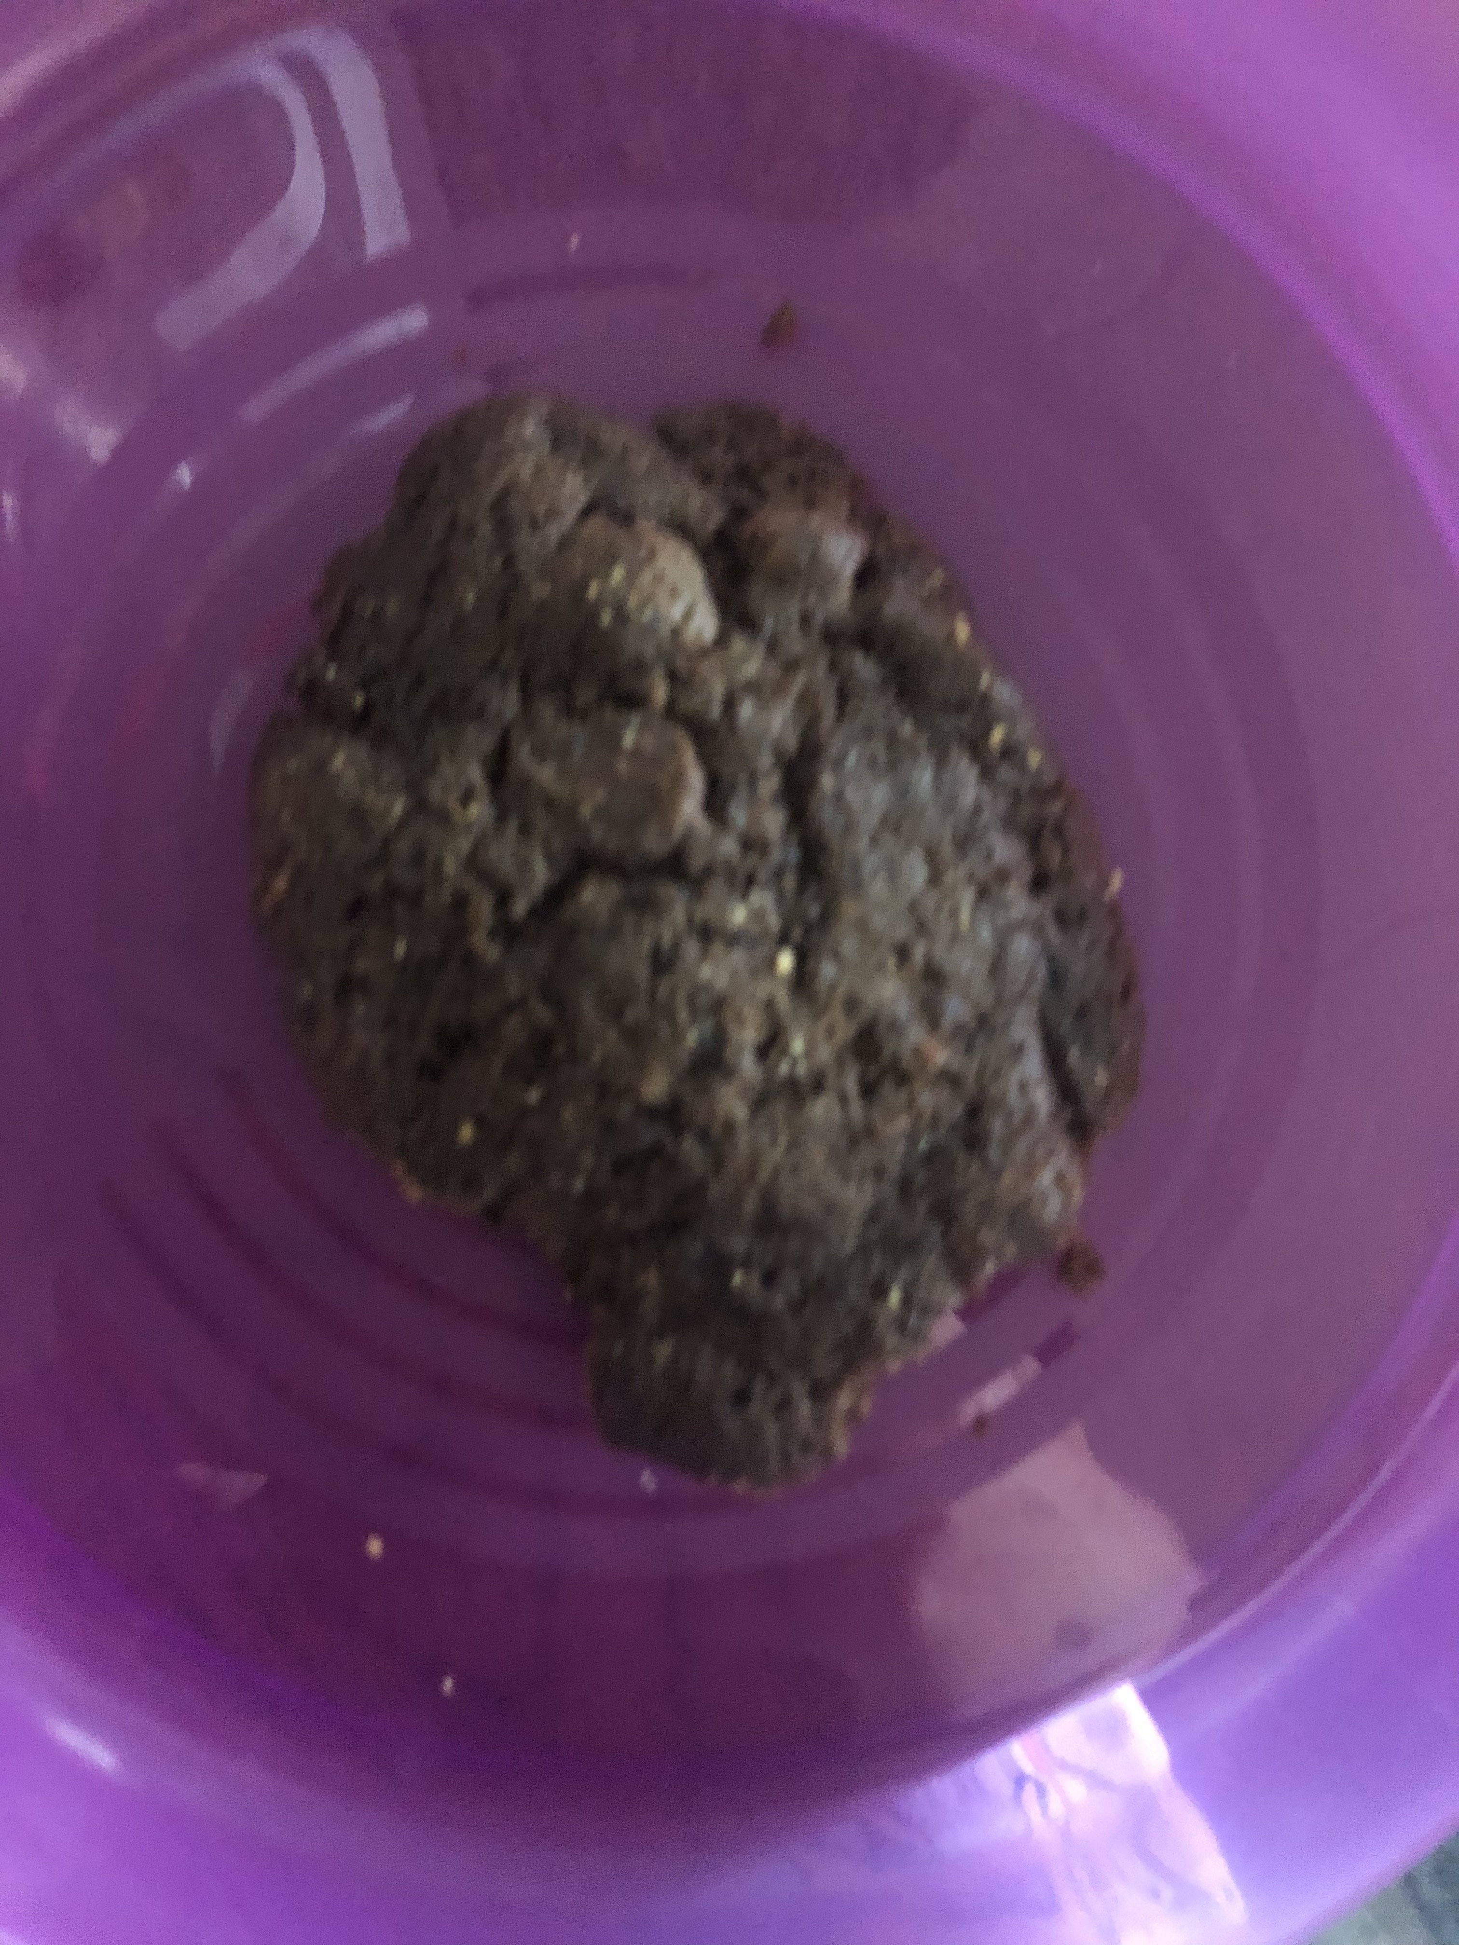
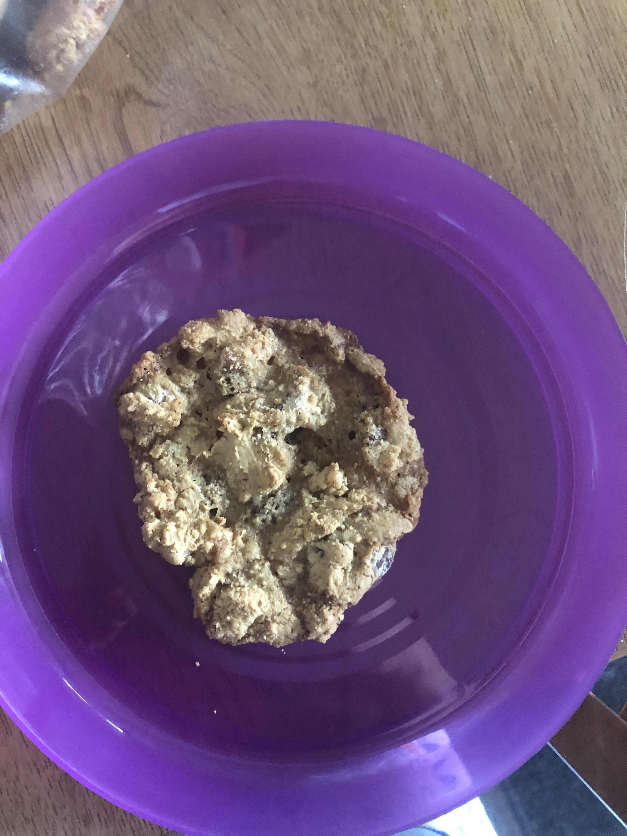
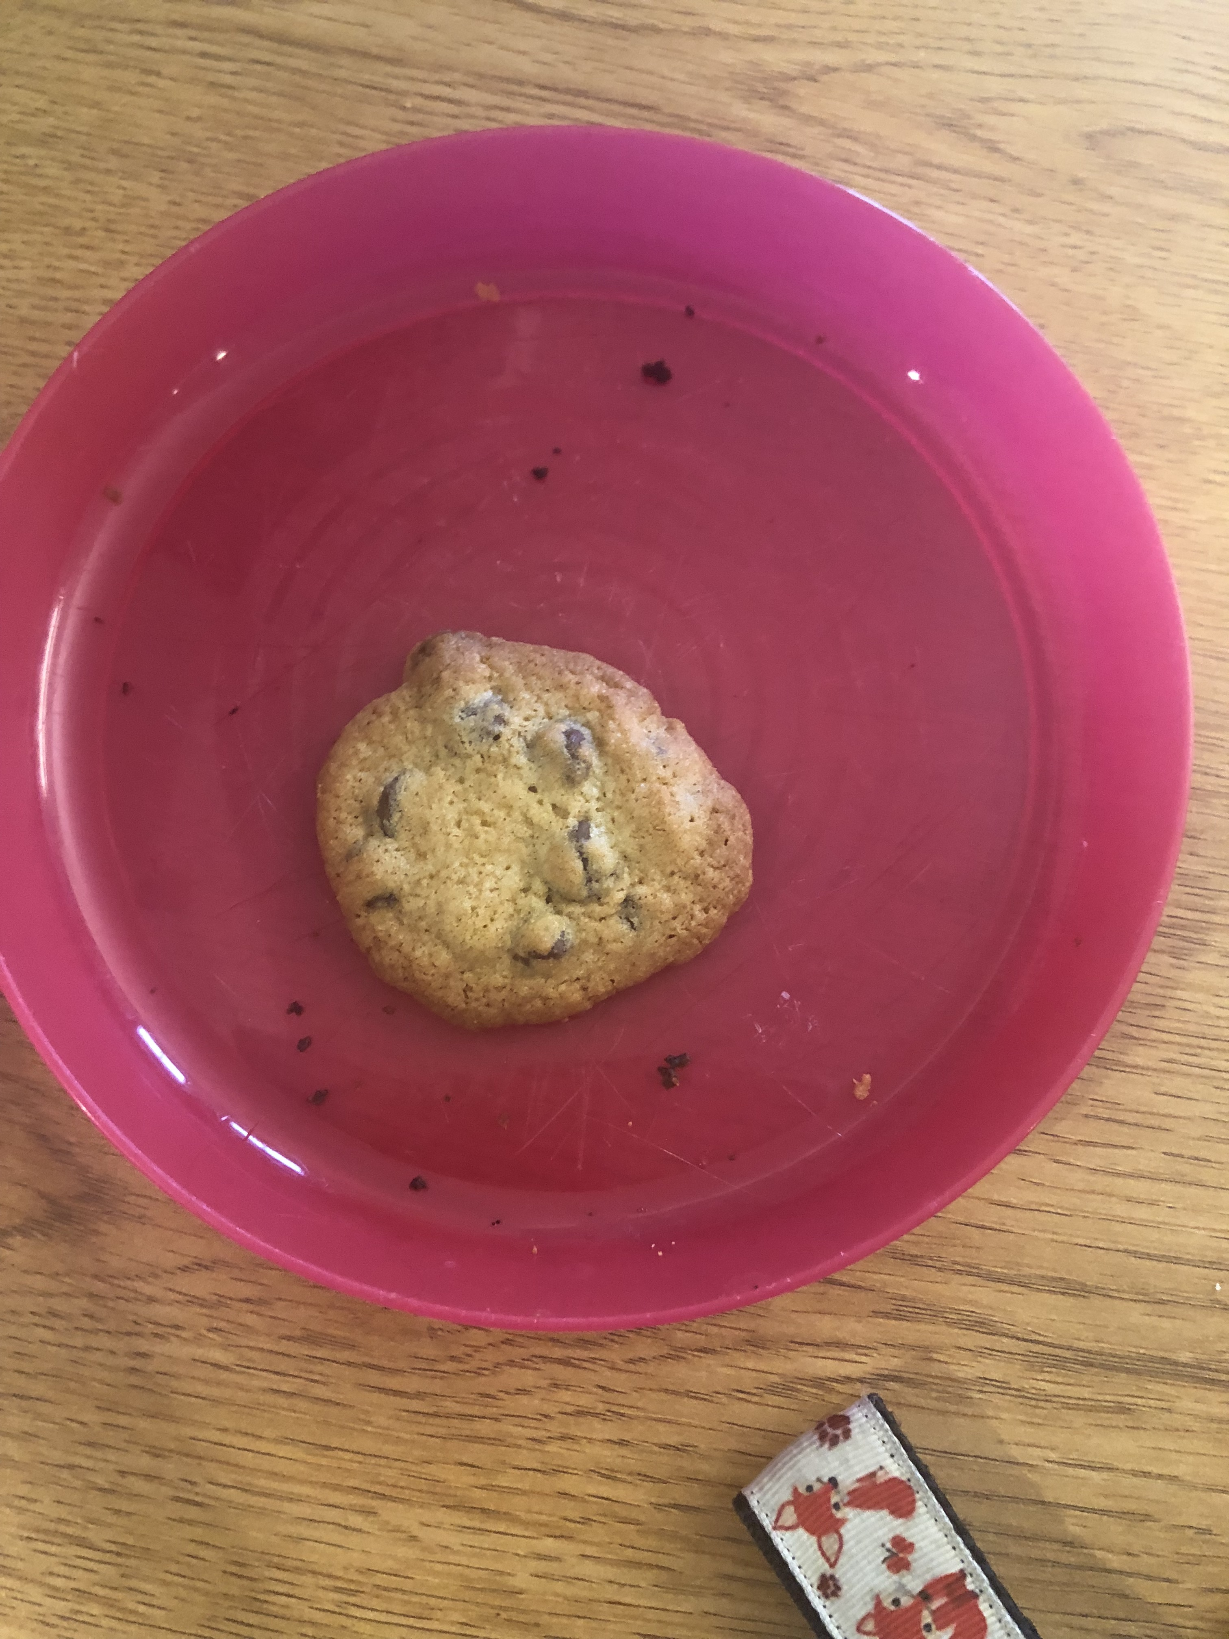
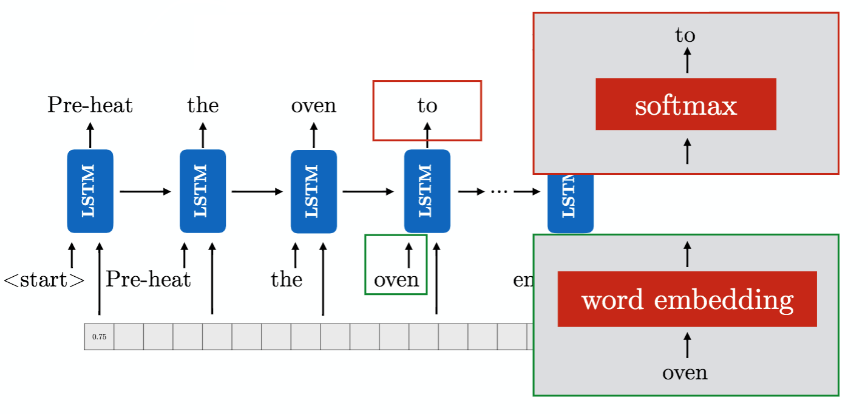
Optimizing Cookie Recipes for Ratings Using Machine Learning and Deep Vector-to-Sequence Recurrent Neural Models Mackenzie O’Brien and Dr. Pablo Rivas
Our Idea
Methodology
Graphs
This project employed machine learning concepts and processes in an attempt to teach a computer an algorithm that outputs a cookie recipe that is comparable to human-made recipes.
The process involved feeding the algorithms a data set of cookie recipes that included details such as ingredients, ratings, and calories. A second algorithm was used to construct instructions for a recipe once ingredients were selected based off of instructions from the dataset of recipes.
The recipes were gathered by scraping the website allrecipes.com for chocolate chip cookie recipes that were compiled in order to “teach” the computer to recognize tasty cookies by looking at things such as reviews, ingredients, and calories.
Gathering Recipes for Data Input
250 chocolate chip cookie recipes were taken from allrecipes.com. This data was then cleaned and used to create ingredients and instructions.
Individual Batches vs Control
Creating Training Models For Ingredients Vectors
Deep Learning Neural Network
This a nonlinear artificial neural network with multiple layers between the input and output layers. Each mathematical manipulation of the data is considered a layer, and complex DNN have many layers.
Extremely Randomized Trees
The algorithm is a variant of the Random Forest regression that picks a decision boundary at random by using the entire sample at each step of the extreme tree.
Gradient Boosting
The gradient boosting algorithm applies the concept of modifying a weak learner to become better at identifying good outcomes more efficiently.
All Batches vs Control
Machine Learning – Control Matched By Email
Diagrams of Networks
Vector-to-Sequence Models to Get Instructions
Long Short-Term Memory Recurrent Neural Network
We used each generated recipe as an attention mechanism, which when combined with LSTM, trains the model to output a sequence of words that it believes are good recipe.
Testing the Cookies
We did 5 taste tests, each time with a different generated cookie against the same control cookie. We alternated which cookie was 1 or 2 and tested on Mondays and Fridays on campus, serving 40 of each cookie. Generally, we got around 30 responses to our survey for each
Conclusion
None of the cookies generated by machine learning beat the control cookie, but we discovered that machine learning algorithms can indeed create tasty chocolate chip cookie recipes. The best algorithm out of those used was Extremely Randomized Trees.
As the vector-to-sequence algorithm is previously untested in other research, the end results leave something to desire in terms of ability to finesse and actual usability. However, it is still an accomplishment to have gotten a working algorithm. Improvements include ensuring that the instructions contain all ingredients in the vector that contain non-zero values and eliminating repeating loops that the algorithm gets stuck on.
Deep Learning Neural Network
Extreme Trees and Gradient Boosting
A
B
C
D
E
Control
Results
Ingredients
Batch B had the best results, but none of the recipes beat the control cookie. Overall, the recipes generated had good responses during experiment tastings. Recipe E had to be modified, as it included no wet ingredients, and thus would not correctly form dough.
LSTM Recurrent Neural Network
Survey Questions
References
Vector-to-Sequence Instructions
Recipe instructions were created, however some were not viable for use, and none generated a sequence that included every ingredient in the recipe fed into it. This may be because our dataset was not robust enough, but that can possibly be remedied through using more recipes during training the algorithm in further testing.
Appearance on a scale of 1 (unfit for consumption) to 5 (Excellent)
Aroma on a scale of 1 (unfit for consumption) to 5 (Excellent)
Taste on a scale of 1 (unfit for consumption) to 5 (Excellent)
Texture: crunchy, chewy, gooey, juicy, soggy, creamy, other
Overall Satisfaction on a scale of 1 (Hated It) to 10 (Loved It)
Clifford, Catherine. “Alphabet Billionaire Eric Schmidt: Google Used A.I. to
Find the Perfect Chocolate Chip Cookie Recipe.” CNBC, CNBC, 29 Jan. 2018.
Kochanski, Greg et al. “Bayesian Optimization for a Better Dessert.” (2017).
Naik, JitendraB.. “Cuisine Classification and Recipe Generation.” (2015).
Notes:
Would like to print copies of each ML recipe to distribute instead of putting on poster to save space

